Slide 1
Ch 12- Formal Grammars of English

Slide 2
Review
Parts of Speech
Basic syntactic/morphological categories that words belong to
Part of Speech tagging
Assigning parts of speech to all the words in a sentence

Slide 3
Outline for Grammar/Parsing
Panini's grammar of Sanskrit was written over two thousand years ago, and is still referenced today in teaching Sanskrit.
Context-Free Grammars and Constituency
Some common CFG phenomena for English
Sentence-level constructions
Top-down and Bottom-up Parsing
Dynamic Programming Parsing

Slide 4
Syntax
Syntax: from Greek syntaxis “setting out together, arrangement’’
Refers to the way words are arranged together, and the relationship between them.
Goal of syntax is to model the knowledge of what people unconsciously have about the grammar of their native language

Slide 5
Syntax
Applications
Grammar checkers
Question answering
Information extraction
Machine translation

Slide 6
key ideas of syntax
Constituency
Subcategorization
Grammatical relations

Slide 7
Context-Free Grammars (CFG)
Capture constituency and ordering
Ordering:
What are the rules that govern the ordering of words and bigger units in the language?
Constituency:
How words group into units and how the various kinds of units behave

Slide 8
Constituency
Noun phrases (NPs) - Exs
Three parties from Brooklyn
A high-class spot such as Mindy’s
The Broadway coppers
They
Harry the Horse
The reason he comes into the Hot Box
How do we know these form a constituent? – Evidence I

Slide 9
Constituency (II)
They can all appear before a verb:
Three parties from Brooklyn arrive…
A high-class spot such as Mindy’s attracts…
The Broadway coppers walk….
They sit
But individual words can’t always appear before verbs:
*from arrive…
*as attracts…
*the is
*spot is…
Must be able to state generalizations like:
Noun phrases occur before verbs

Slide 10
Constituency (III)
Evidence II for constituency:
Preposed and postposed constructions:
Ex: the prepositional phrase on September seventeenth can be placed in a number of different locations in the following examples, including preposed at the beginning, and postposed at the end
On September 17th, I’d like to fly from Atlanta to Denver
I’d like to fly on September 17th from Atlanta to Denver
I’d like to fly from Atlanta to Denver on September 17th.
But not: while the entire phrase can be placed differently, the individual words making up the phrase cannot be
*On September, I’d like to fly 17th from Atlanta to Denver
*On I’d like to fly September 17th from Atlanta to Denver

Slide 11
CFG example
S -> NP VP
NP -> Det NOMINAL
NOMINAL -> Noun
VP -> Verb
Det -> a
Noun -> flight
Verb -> left

Slide 12
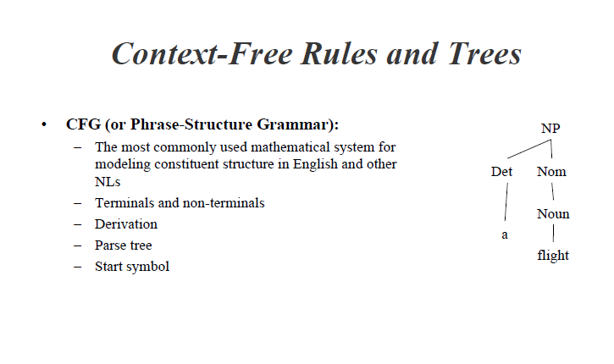

Slide 13
CFGs: set of rules
S -> NP VP
This says that there are units called S, NP, and VP in this language
That an S consists of an NP followed immediately by a VP
Doesn’t say that that’s the only kind of S
Nor does it say that this is the only place that NPs and VPs occur

Slide 14
Generativity
As with FSAs can view these rules as either analysis or synthesis machines
Generate strings in the language
Reject strings not in the language
Impose structures (trees) on strings in the language
How can we define grammatical vs. ungrammatical sentences?

Slide 15
Derivations
A derivation is a sequence of rules applied to a string that accounts for that string
Covers all the elements in the string
Covers only the elements in the string

Slide 16
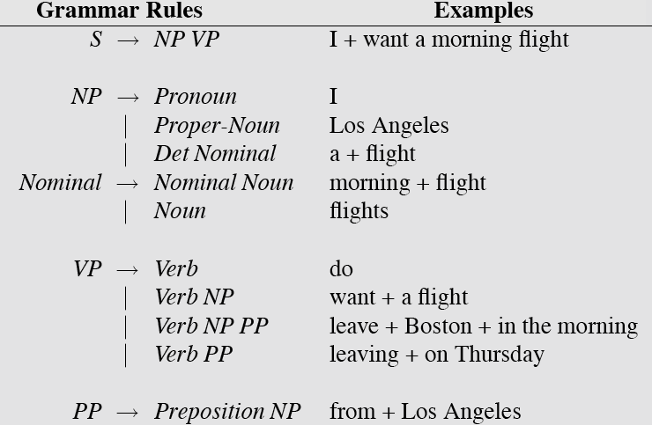

Slide 17
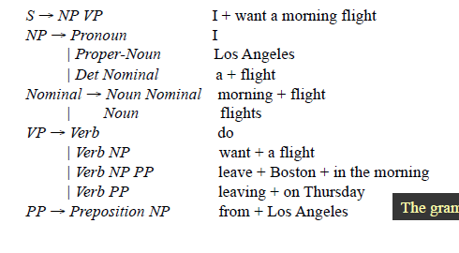
The grammar
Derive “I prefer a morning flight” – top down and bottom up

Slide 18
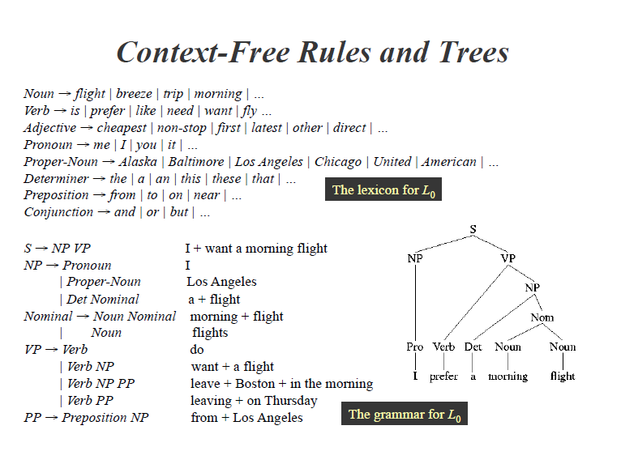

Slide 19
Derivations as Trees
S
NP
VP
NP
Nom
Pro
Verb
Det
Noun
Noun
I
prefer
a
morning
flight

Slide 20
CFGs more formally
A context-free grammar has 4 parameters
(“is a 4-tuple”)
A set of non-terminal symbols (“variables”) N
A set of terminal symbols Σ (disjoint from N)
A set of productions P, each of the form
A -> α
Where A is a non-terminal and α is a string of symbols from the infinite set of strings (Σ ∪ N)*
A designated start symbol S

Slide 21
Defining a CF language via derivation
A string A derives a string B if
A can be rewritten as B via some series of rule applications
More formally:
If A -> β is a production of P
α and γ are any strings in the set (Σ ∪ N)*
Then we say that
αAγ directly derives αβγ or αAγ ⇒ αβγ
Derivation is a generalization of direct derivation
Let α₁, α₂, … α_{m} be strings in (Σ ∪ N)*, m>= 1, s.t.
α₁⇒ α₂, α₂⇒ α₃… α_{m-1}⇒ α_{m}
We say that α₁derives α_{m} or α1*⇒ α_{m}
We then formally define language L_{G} generated by grammar G
A set of strings composed of terminal symbols derived from S
L_{G} = {w | w is in Σ* and S *⇒ w}

Slide 22
Parsing
Parsing is the process of taking a string and a grammar and returning a (many?) parse tree(s) for that string

Slide 23
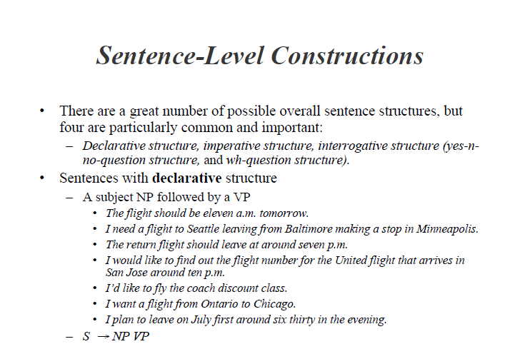

Slide 24
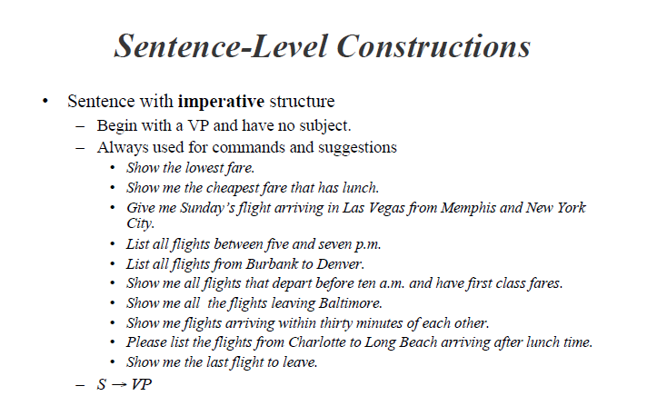

Slide 25
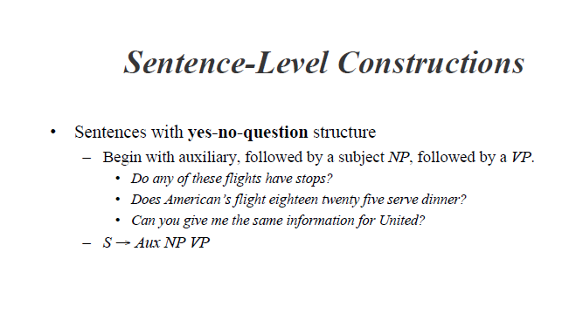
Note- Aux: auxiliary verb

Slide 26
Sentence Level Constructions
Wh- structure types:
wh-subject-question structure
wh-non-subject question structure

Slide 27
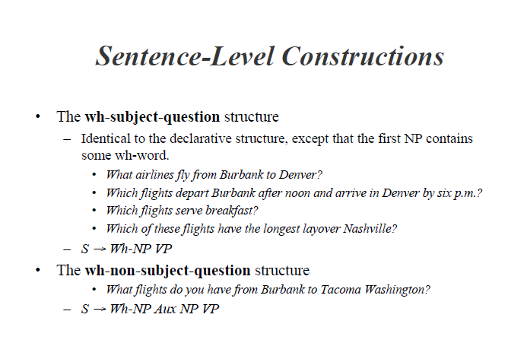
Note: wh- structures: named because one of their constituents is a wh-phrase, one that includes a wh-word (who, whose, when, where, what, which, how, why).

Slide 28
Sentence Level Constructions
Wh- structure types:
wh-non-subject question structure
In the wh-non-subject question structure
the wh-phrase is not the subject of the sentence
and so the sentence includes another subject
In these types of sentences the auxiliary appears before the subject NP, just as in the yes-no-question structures
Yes-no question structure: S -> Aux NP VP
wh-non-subject question structure : S -> Wh-NP Aux NP VP

Slide 29
Sentence-Types: Summary
Declaratives: A plane left
S -> NP VP
Imperatives: Leave!
S -> VP
Yes-No Questions: Did the plane leave?
S -> Aux NP VP
Wh Questions: wh-subject-question structure
What airlines fly from Burbank to Denver?
S-> Wh-NP VP
Wh Questions: wh-non-subject question structure
When did the plane leave?
S -> Wh-NP Aux NP VP

Slide 31
Clauses and Sentences
S rules are intended to account for entire sentences that stand alone as fundamental units of discourse.
S can also occur on the right-hand side of grammar rules and hence can be embedded within larger sentences
S is a node of the parse tree below which the main verb of the S has all of its arguments.
illustration from the tree: I prefer a morning flight

Slide 32
Clauses and Sentences
S
NP
VP
NP
Nom
Pro
Verb
Det
Noun
Noun
I
prefer
a
morning
flight
Illustration from the tree: I prefer a morning flight
The verb prefer has two arguments:
the subject I
the object a morning flight
One of the arguments appears below the VP node, but the other one, the subject NP, appears below the S node

Slide 33
Key Constituents (English)
Sentences
Noun phrases
Verb phrases
Prepositional phrases

Slide 34
NPs
NP -> Pronoun
I came, you saw it, they conquered
NP -> Proper-Noun
Los Angeles is west of Texas
John Hennessy is the president of Stanford
NP -> Det Noun
The president
NP -> Nominal
Nominal -> Noun Noun
A morning flight to Denver

Slide 35
The Noun Phrase
View the NP as revolving around a head, the central noun in the NP
The syntax of English allows for both
pre-nominal (pre-head) modifiers
and post-nominal (post-head) modifiers
The grammar for Noun Phrase
S -> NP VP
NP-> Pronoun
Proper-Noun
Det Nominal
Nominal -> Nominal Noun
Noun

Slide 36
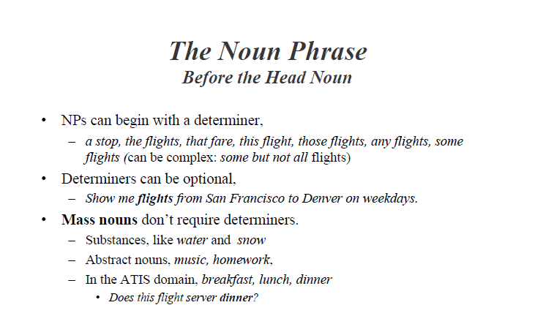

Slide 37
The Noun Phrase
The Determiner:
The role of the determiner in English noun phrases can also be filled by more complex expressions, as follows:
United's flight
United's pilot's union
Denver's mayor's mother's canceled flight
the role of the determiner is filled by a possessive expression con-sisting of a noun phrase followed by an 's as a possessive marker, as in the following rule.
Det → NP ′s
this rule is recursive (since an NP can start with a Det), will help us model the latter two examples above, where a sequence of possessive expressions serves as a determiner.
NP-> Pronoun
Proper-Noun
Det Nominal
Nominal -> Nominal Noun
Noun

Slide 38
The Noun Phrase
Draw parse tree for X’s Y’s sentence construction
S -> NP VP
NP-> Pronoun
Proper-Noun
Det Nominal
VP → Verb| Verb NP | Verb PP | Verb NP PP
Nominal -> Nominal Noun|Noun
Preposition → Preposition NP
Det → NP ′s
Det → the|a|an|this|these|that
Draw parse tree for X’s Y’s Z’s sentence construction
Note: X, Y and Z are nouns here

Slide 39
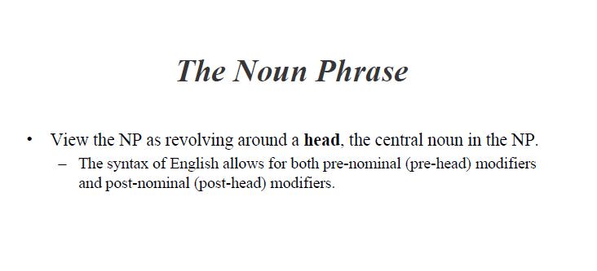

Slide 40
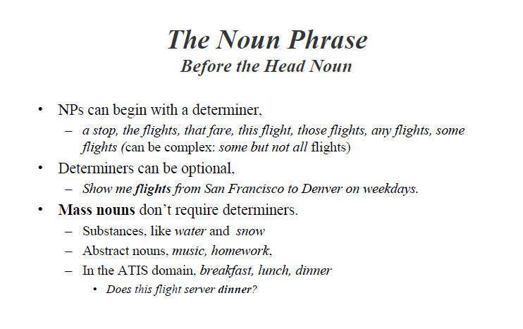

Slide 41
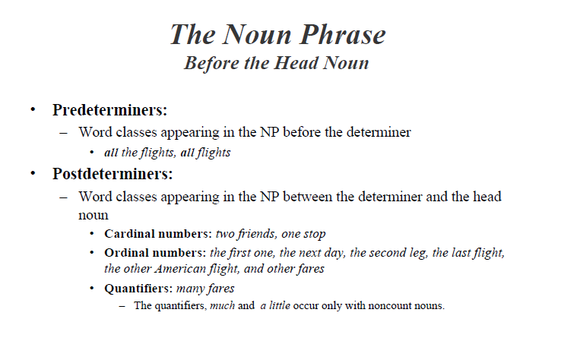
Note: read “and other fares” as and other fares
Some quantifiers (many, (a) few, several) occur only with plural count nouns: many fares

Slide 42
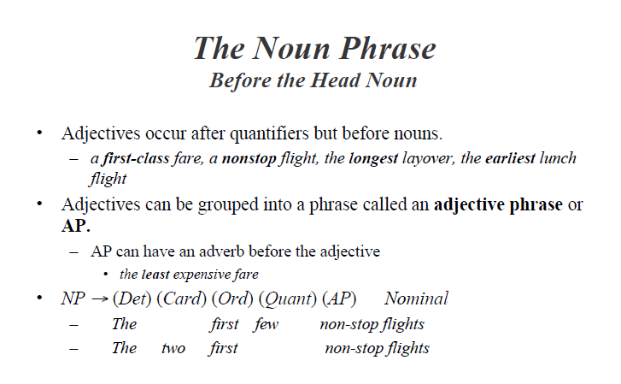
Note: the use of parentheses “( )” to mark optional constituents.

Slide 43
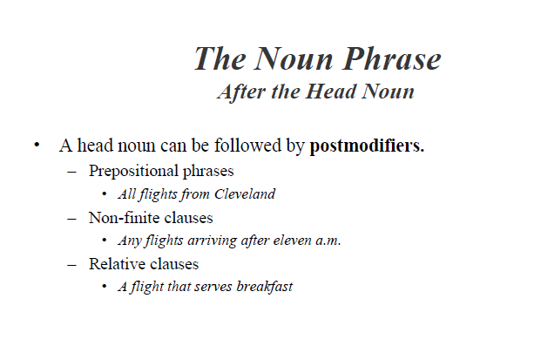
Note: All post head modifiers follow Nominal and Grammar rules are framed for Nominal. Ex: Nominal → Nominal PostHeadModifiers where PostHeadModiferes are prepositional Phrases or Nonfinite Modifiers or Relative clauses

Slide 44
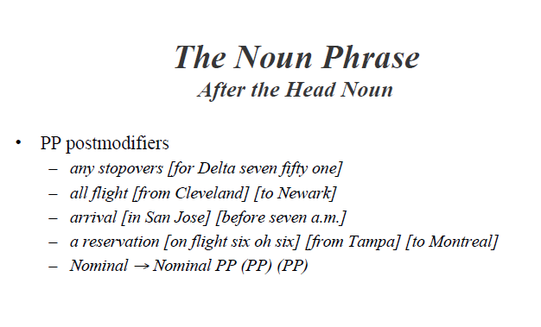

Slide 45
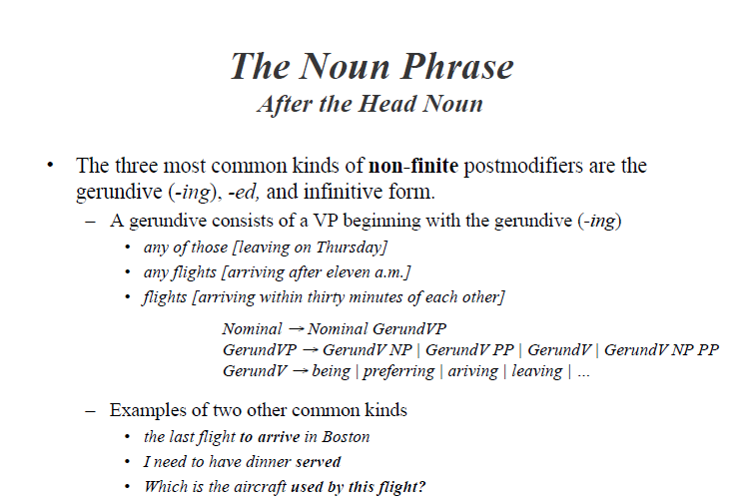

Slide 46
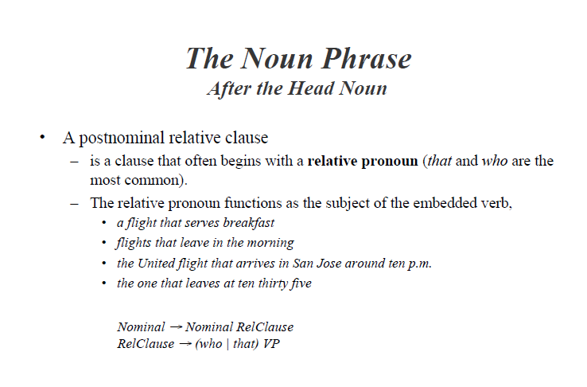

Slide 47
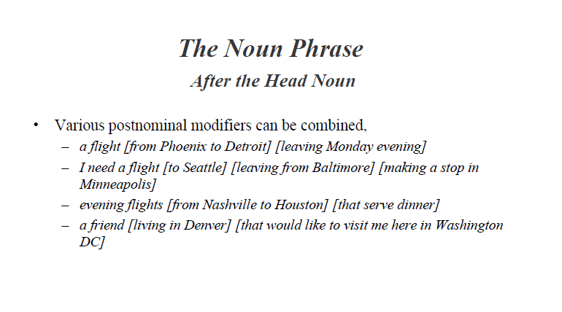

Slide 48
Problem Stmt
Draw Parse tree for “all the morning flights from Denver to Tampa leaving before 10”

Slide 49
CFG
S → NP VP
NP → Pre-Head-Modifiers Nominal Post-Head-Modifiers
Pre-Head-Modifiers → PreDet Det Post-Determiners
Post-Determiners → (Card) (Ord) ( Quant) (AP)
NP → Pronoun|Proper-Noun|Det Nominal
Det → NP’s
Nominal → Nominal Noun|Noun
Pre-head-Modifiers → (Card)(Ord)(Quant)(AP)
Nominal → Nominal PP (PP) (PP)
Nominal → Nominal GerundVP
Nominal → Nominal RelCluase
Nominal → (Nominal PP (PP) (PP)) | (Nominal GerundVP) | (Nominal RelCluase)
RelClause → (who|that) VP
GerundVP → GerundV| GerundV NP | GerundV PP | GerundV NP PP
VP → Verb| Verb NP | Verb PP | Verb NP PP
PP → Preposition NP
Note: Post-head-Modifiers → PP-Modifier | Non-finite-Modifier| Rel-Clause-Modifier
PP-Modifier : Nominal → Nominal PP (PP) (PP)
Non-finite-Modifier: Nominal → Nominal GerundVP
Rel-Clause-Modifer : Nominal → Nominal RelCluase

Slide 50
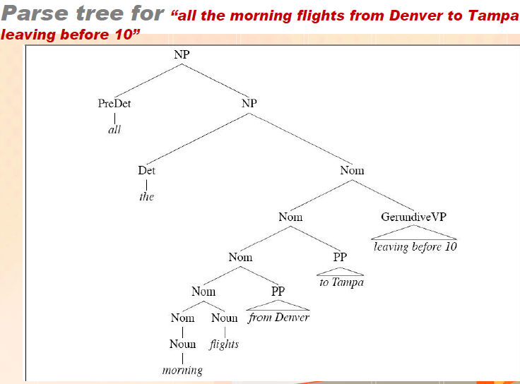

Slide 51
Third Person - Background
Third Person (singular) | Subjective Case | Objective Case | Possessive Case
 | he (masculine) she (feminine) it (neuter) | him (masculine) her (feminine) it (neuter) | his/his (masculine) her/hers (feminine) its/its (neuter)
Third Person (plural) | Subjective Case | Objective Case | Possessive Case
 | they | them | their/theirs

Slide 52
First Person vs. second person - - Background
First Person (singular, plural) | Subjective Case | Objective Case | Possessive Case
 | I, we | me, us | my/mine, our/ours
Second Person (singular & plural) | Subjective Case | Objective Case | Possessive Case
 | you | you | your/yours
In grammatical terms, first person, second person, and third person refer to personal pronouns

Slide 53
Bracketed Notation
[_{S} [_{NP} [_{PRO} I]] [_{VP} [_{V} prefer] [_{NP} [_{Det} a] [_{Nom} [_{N} morning] [_{N} flight] ] ] ] ]
S
NP
VP
NP
Nom
Pro
Verb
Det
Noun
Noun
I
prefer
a
morning
flight

Slide 54
Agreement
Verbs in English can appear in two forms in the present tense:
the form used for third-person, singular subjects (the flight does),
and the form used for all other kinds of subjects (all the flights do, I do)
The third-person-singular (3sg) form usually has a final -s
the non-3sg form does not
Examples, using the verb do:
Do [NP all of these flights] offer first class service?
Do [NP I] get dinner on this flight?
Do [NP you] have a flight from Boston to ForthWorth?
Does [NP this flight] stop in Dallas?
Examples with the verb leave:
What flights leave in the morning?
What flight leaves from Pittsburgh?
Note: 1) Rule handling yes-no-questions S → Aux NP VP
2) wh-subject-question structure : S → Wh-NP Aux NP VP
3) wh-non-subject question structure S → Wh-NP Aux NP VP

Slide 55
Agreement
Agreement: Types
Subject-verb agreement or NV (Noun–Verb) agreement
Determiner-Noun agreement
Gender Agreement
This agreement phenomenon occurs whenever there is a verb that has some noun acting as its subject.
Note: sentences in which the subject does not agree with the verb are ungrammatical:
*[What flight] leave in the morning?
*Does [NP you] have a flight from Boston to ForthWorth?
*Do [NP this flight] stop in Dallas?
Note: Subject (or Nouns) and Verbs for above cases:
1. Subject(or noun) is flight, Verb is leave
2. Subject(or noun) is you, Verb is Does
3. Subject(or noun) is this, Verb is Do

Slide 56
Agreement
Subject-verb agreement
How to modify our grammar to handle these agreement phenomena?
One way is to expand our grammar with multiple sets of rules
one rule set for 3sg subjects, and
one for non-3sg subjects
Ex: the rule handling yes-no-questions
S → Aux NP VP
We could replace this with two rules of the following form:
S → 3sgAux 3sgNP VP
S → Non3sgAux Non3sgNP VP
We could then add rules for the lexicon like these:
3sgAux → does | has | can | . . .
Non3sgAux → do | have | can | . . .

Slide 57
Agreement
Subject-verb agreement
But we would need to add rules for 3sgNP and Non3sgNP
again by making two copies of each rule for NP
3SgNP → Det SgNominal
Non3SgNP → Det PlNominal
SgNominal → SgNoun
PlNominal → PlNoun
SgNoun → flight | fare | dollar | reservation | . . .
PlNoun → flights | fares | dollars | reservations | . . .
Exercise question: Deal with the first and second person pronouns

Slide 58
Agreement
Problems with Number Agreement Rules:
The problem with this method of dealing with number agreement is
it doubles the size of the grammar
Every rule that refers to a noun or a verb needs to have a
“singular” version and
a “plural” version
2) Determiner-Noun agreement
Along with subject-verb agreement, need to introduce copies of rules to capture the fact that head nouns and their determiners have to agree in number :
this flight *this flights
those flights *those flight

Slide 59
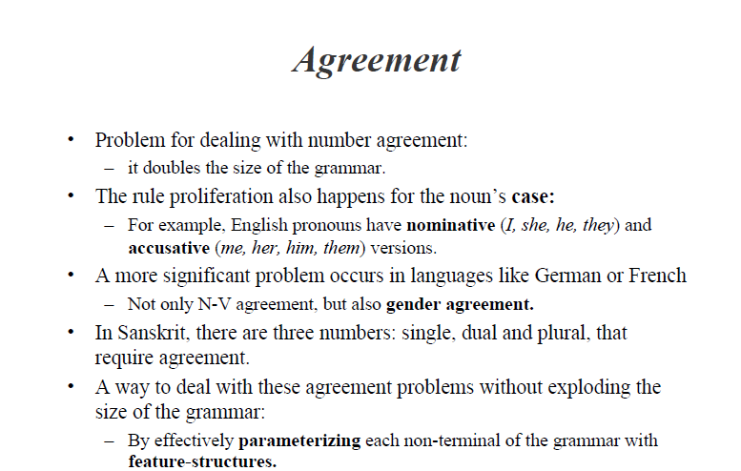
3. Gender agreement

Slide 60
The Verb Phrase and Subcategorization
The verb phrase consists of the verb and a number of other constituents.
Simple rules we have built so far, these other constituents include NPs and PPs and combinations of the two:
VP → Verb ;disappear
VP → Verb NP ; prefer a morning flight
VP → Verb NP PP ; leave Boston in the morning
VP → Verb PP ; leaving on Thursday
What are the other constituents of VP?

Slide 61
The Verb Phrase and Subcategorization
Verb phrases can be significantly more complicated
Many other kinds of constituents can follow the verb, such as an entire embedded sentence.
These are called sentential complements:
You [VP [V said [S there were two flights that were the cheapest ]]]
You [VP [V said [S you had a two hundred sixty six dollar fare]]
[VP [V Tell] [NP me] [S how to get from the airport in Philadelphia to downtown]]
I [VP [V think [S I would like to take the nine thirty flight]]
Rule for these:
VP → VP S
Note: In bracketed notations, start tracing the brackets from innermost to the outermost.

Slide 62
The Verb Phrase and Subcategorization
Another potential constituent of the VP is another VP.
This is often the case for verbs like want, would like, try, intend, need:
I want [VP to fly from Milwaukee to Orlando]
Hi, I want [VP to arrange three flights]
Hello, I’m trying [VP to find a flight that goes from Pittsburgh to Denver after two p.m.]
VP → VP VP

Slide 63
The Verb Phrase and Subcategorization
A verb phrase can have
many possible kinds of constituents
but not every verb is compatible with every verb phrase
Ex: the verb want can either be used
with an NP complement (I want a flight . . . ), or
with an infinitive VP complement (I want to fly to . . . ).
But a verb like find cannot take this sort of VP complement
(* I found to fly to Dallas)
Traditional grammar distinguishes between
transitive verbs like find, which take a direct object NP (I found a flight) and
intransitive verbs like disappear, which do not take NP (*I disappeared a flight)

Slide 64
The Verb Phrase and Subcategorization
Traditional grammars subcategorize verbs into these two categories
Transitive and intransitive
modern grammars distinguish as many as 100 subcategories
Subcategorisation
We say that a verb like find subcategorizes for an NP,
while a verb like want subcategorizes for either an NP or a non-finite VP
We call these constituents the complements of the verb
So we say that want can take a VP complement.
These possible sets of complements are called the subcategorization frame for the verb.
Note: use of the term sentential complement

Slide 65
The Verb Phrase and Subcategorization
Represent the relation between verbs and their complements in a context-free grammar
Each VP rule could be modified to require the appropriate verb subtype:
VP → Verb-with-no-complement ;disappear
VP → Verb-with-NP-comp NP ;prefer a morning flight
VP → Verb-with-S-comp S ;said there were two flights
VP → Verb-with-Inf-VP-complement ; want to go
make separate subtypes of the class Verb
Verb-with-NP-complement → find | leave | repeat | . . .
Verb-with-S-complement → think | believe | say | . . .
Verb-with-Inf-VP-complement → want | try | need | . . .
Verb-with-no-complement → disappear
Note: the rule VP → Verb is decomposed as above

Slide 66
The Verb Phrase and Subcategorization
The problem with this approach, is same as agreement feature problem
vast explosion in the number of rules
The standard solution to both of these problems is the feature structure
Note: nouns, adjectives, and prepositions can subcategorize for complements just as verbs can

Slide 67
The Verb Phrase and Subcategorization
Another way is to think of the verb as a logical predicate and the constituents as logical arguments of the predicate.
So we can think of such predicate-argument relations as
FIND(I, A FLIGHT), or
WANT(I, TO FLY).

Slide 68
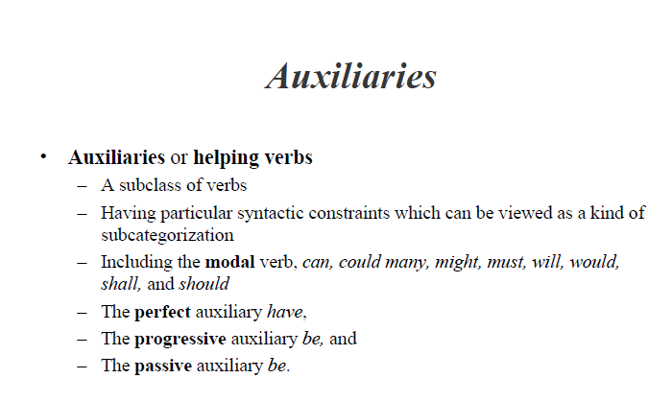
Note the correction: “may” instead of “many”

Slide 69
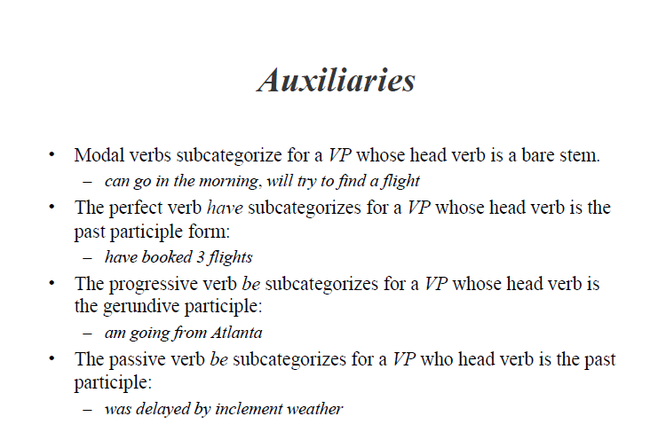

Slide 70
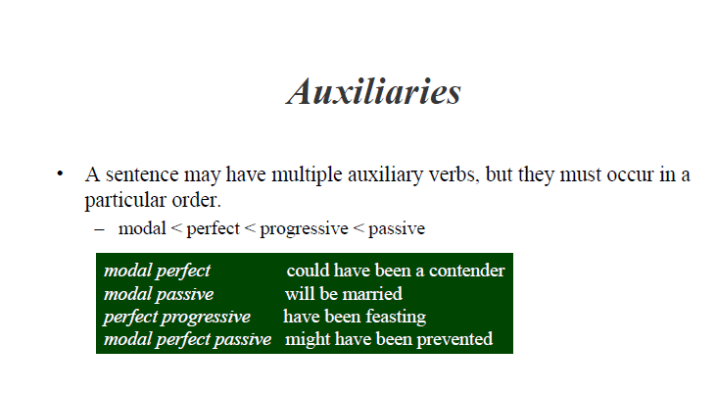

Slide 71
Coordination
The major phrase types discussed so far can be conjoined with conjunctions to form larger constructions of the same type.
conjunctions - and, or, and but
Forms of coordination
Noun phrases
Nominals
Verb phrases
S

Slide 72
Coordination
Coordinate noun phrase can consist of two other noun phrases separated by a conjunction:
Please repeat [NP [NP the flights] and [NP the costs]]
I need to know [NP [NP the aircraft] and [NP the flight number]]
Rule that allows these structures:
NP → NP and NP

Slide 73
Coordination
Coordinate involving nominals
Please repeat the [Nom [Nom flights] and [Nom costs]]
I need to know the [Nom [Nom aircraft] and [Nom flight number]]
Nominal → Nominal and Nominal

Slide 74
Coordination
Coordinate NP vs. Coordinate Nominal:
Coordinate NP:
Please repeat [NP [NP the flights] and [NP the costs]]
I need to know [NP [NP the aircraft] and [NP the flight number]]
Coordinate Nominal:
Please repeat the [Nom [Nom flights] and [Nom costs]]
I need to know the [Nom [Nom aircraft] and [Nom flight number]]
Note: The examples for coordinate NPs differ from Coordinate Nominals by the lack of second determiner

Slide 75
Coordination
Conjunctions involving VPs and Ss:
What flights do you have [VP [VP leaving Denver] and [VP arriving in San Francisco]]
[S [S I’m interested in a flight from Dallas to Washington] and [S I’m also interested in going to Baltimore]]
The rules for VP and S conjunctions
VP → VP and VP
S → S and S

Slide 76
Coordination
Representing Conjunctions – more generally:
All the major phrase types conjoined can be represented more generally via metarules :
X → X and X
Meta rule states that any non-terminal can be conjoined with the same nonterminal to yield a constituent of the same type
Note: the variable X must be designated as a variable that stands for any non-terminal rather than a non-terminal itself.

Slide 77
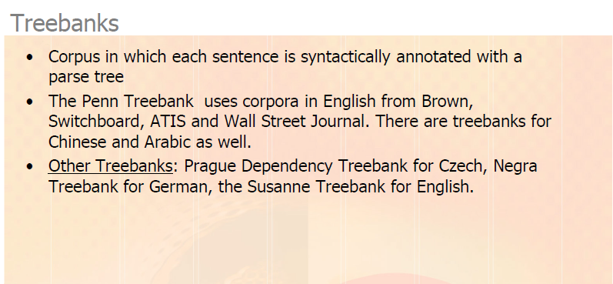

Slide 78
Treebanks
Parsed corpora in the form of trees
The Penn Treebank
The Brown corpus
The WSJ corpus
Tgrep
http://www.ldc.upenn.edu/ldc/online/treebank/
Tregex
http://www-nlp.stanford.edu/nlp/javadoc/javanlp/

Slide 79
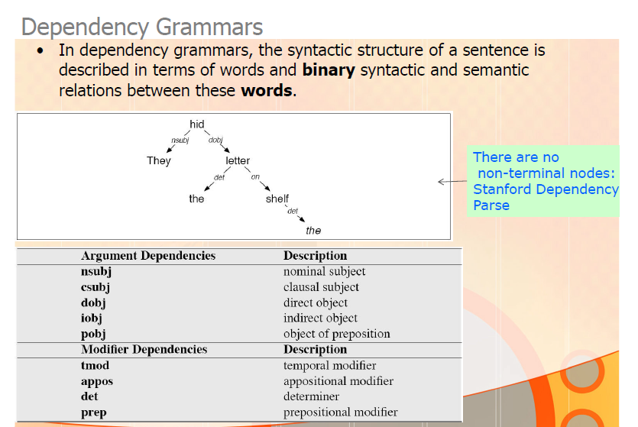

Slide 80
Dependency parsing
Word to word links instead of constituency
Based on the European rather than American traditions
But dates back to the Greeks
The original notions of Subject subcategorization came out of Dependency theory.
Dependency parsing is quite popular as a computational model since relationships between words are quite useful

Slide 81
Parse tree vs. Dependency parsing
S
NP
VP
Parse tree:
Nesting of multi-word constituents
VBD
VP
NP
PP
IN
NP
VBN
PP
NNS
IN
NP
NNS
CC
NN
NNP
NNP
Bills on ports and immigration were submitted by Senator Brownback
submitted
nsubjpass
auxpass
agent
Typed dep parse:
Grammatical relations between individual words
Bills
were
Brownback
prep_on
nn
ports
Senator
conj_and
immigration

Slide 82
Why are dependency parses useful?
Example: multi-document summarization
Need to identify sentences from different documents that each say roughly the same thing:
phrase structure trees of paraphrasing sentences which differ in word order can be significantly different
but dependency representations will be very similar

